Slide 1






Aeroguard

Slide 2
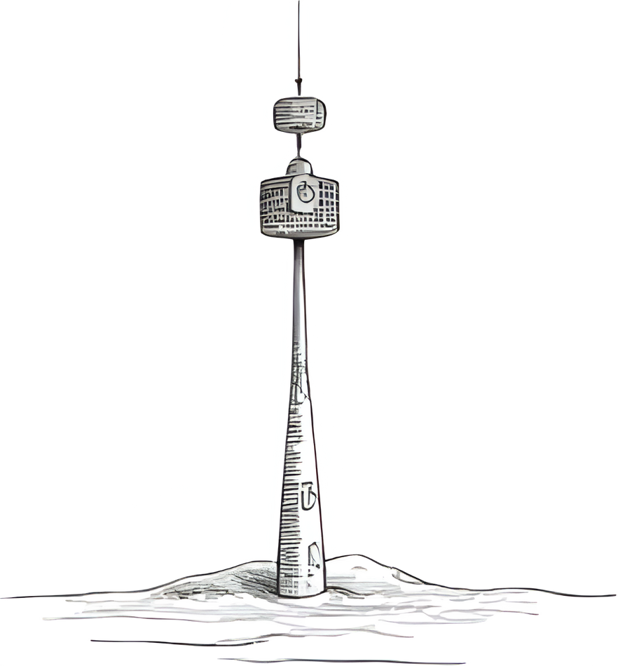
Problems
Modern Warfare: Drones are a cheap, key tool attacking stationary targets, critical infrastructure, and border areas.
Lack of Scalability: Conventional methods are too slow or too expensive when facing a massive attack of multiple objects simultaneously.

Slide 3
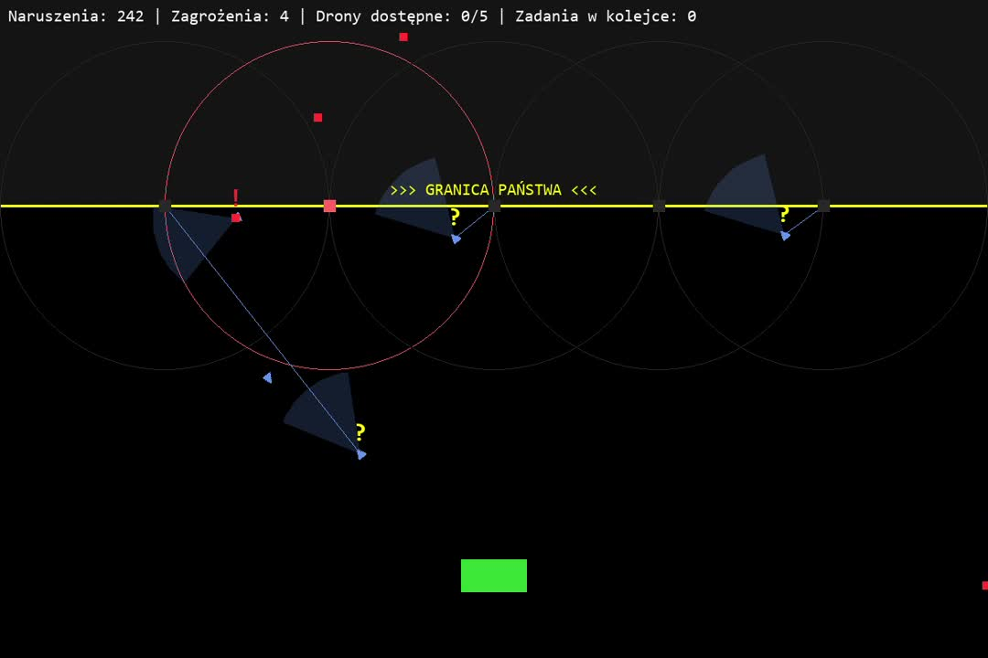
Solution
Identification: After detection by radar and IR/thermal sensors, the drone is dispatched to identify the target (Friend or Foe).
Full Autonomy of Decision: The AI algorithm decides: Neutralization OR Information Relay to the command center.
Continuous Tracking: Even after relaying information, the drone continues to actively track the target, maintaining situational awareness until a final decision is made.

Slide 4
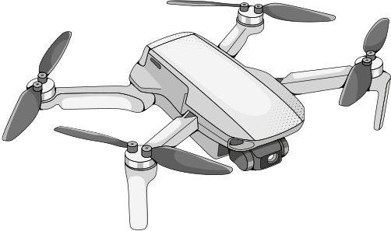
Market
BORDER GUARDS
Primary Goal: Border Monitoring and prevention of airspace violations.
Key Value: Patrol mode, Thermal Camera, Increased Area Coverage.
MILITARY
Primary Goal: Fast, scalable Defense against massive attacks and protection of military assets.
Key Value: Drastic Cost Reduction: Countering small drones with cheap defender drones (instead of expensive missile systems).

Slide 5

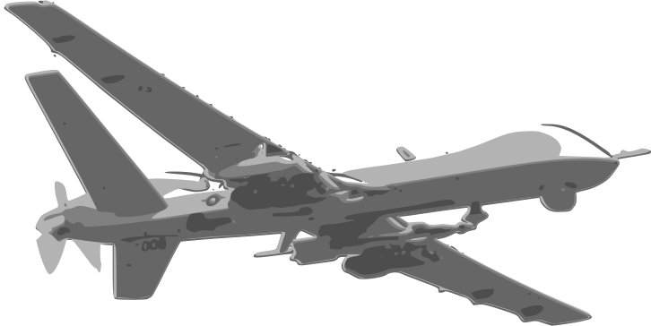
Tech solution
AI: Computer Vision (DL) algorithms for autonomous target tracking, identification, and neutralization decision-making.
Sensor System: Integrated ground radar + Thermal Cameras on drones (for ISR, night targeting/human detection).
Flexible Reaction Variants:
Variant 1: Net Launcher: For non-destructive neutralization (rotor blocking). Drone can return or engage another target after attack.
Variant 2: Kamikaze Drone: Self-detonation to destroy the target. This is the ultimate, precise solution for critical threats.

Slide 6
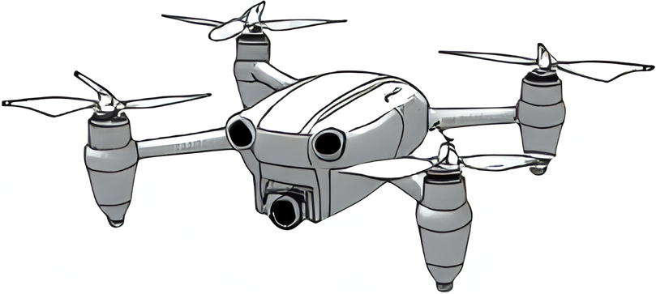
Strategic Integration (Hive Mind): Development toward a centralized management system ("Hive Mind") that coordinates dozens of defender drones simultaneously.
Resource Optimization: The Hive Mind optimizes drone deployment, minimizing operational costs and defense gaps.
Geographical Scalability: Integrating the system on a larger scale (e.g., entire national border), ensuring full coverage and centralized oversight.
Opportunities

Slide 7
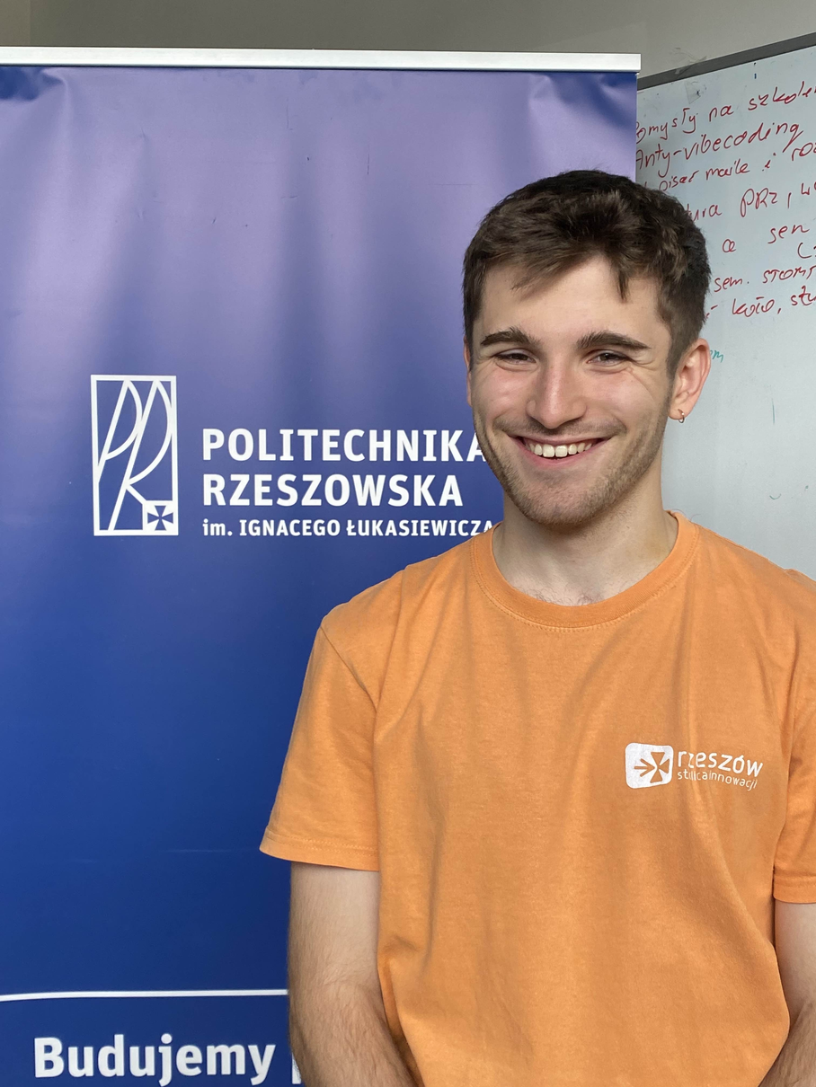
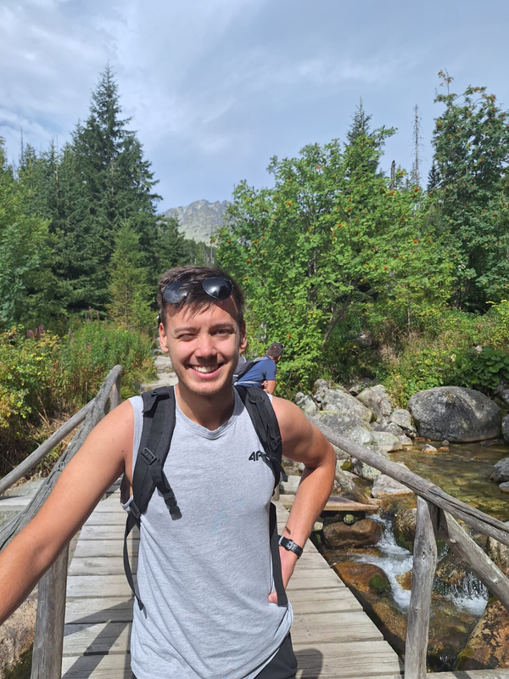
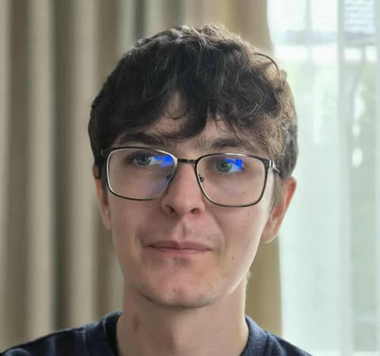
Our team
Mateusz Gałda (PM)
Maciek Gilecki
Paweł Górski

